Slide 1
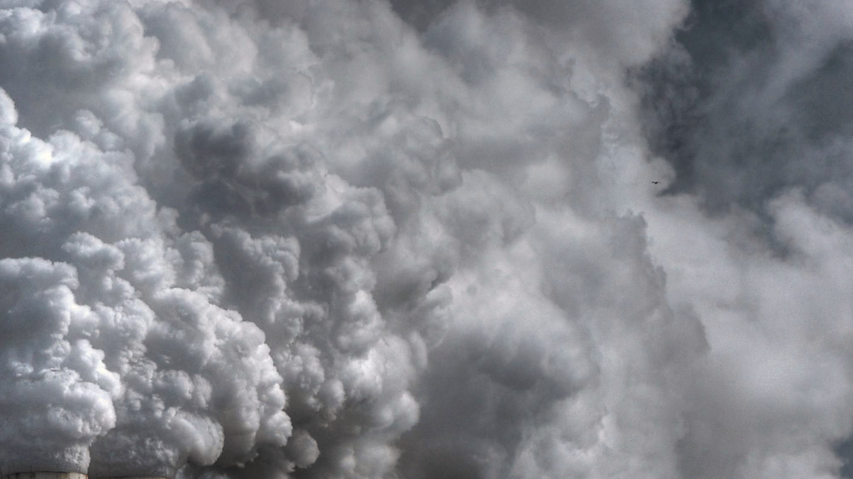

Source attributed LOTOS-EUROS Elemental carbon compared with fossil fuel and wood burn attributed observations
22nd Task Force on Measurement and Modelling Meeting
10-05-2021
Janot Tokaya*,
Renske Timmermans,
Richard Kranenburg,
Augustin Colette,
John Douros
Stephen Matthew Platt
*janot.tokaya@tno.nl

Slide 2

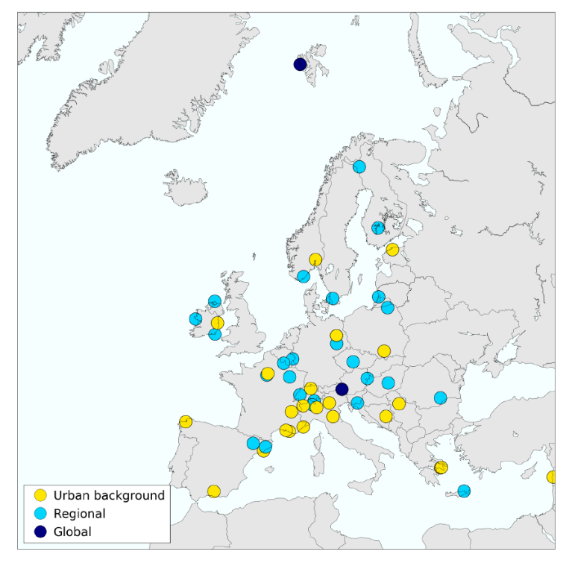
EURODELTA-CARB project
Introduction
EMEP/ACTRIS/COLOSSAL field campaign stations
Joint EMEP/CAMS model intercomparison
Compare with EMEP/ACTRIS/COLOSSAL field campaign (Winter 2017-2018: EC tagging PMF)
Scope:
Testing inventories including/excluding condensables
EMEP report 2019:
“The condensable component of particulate matter is probably the largest single source of uncertainty in PM emissions.”
52 Measurements sites:
  -2 global sites
  -25 regional background
  -25 urban background sites
in 22 countries
Notes:
EMEP- European Monitoring and Evaluation Programme

Slide 3

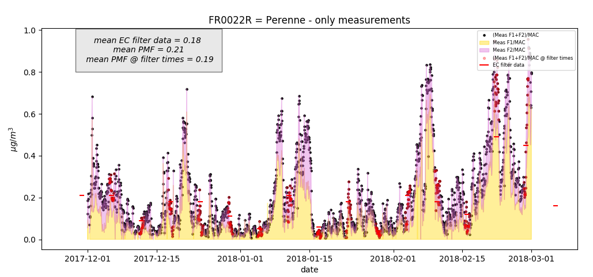
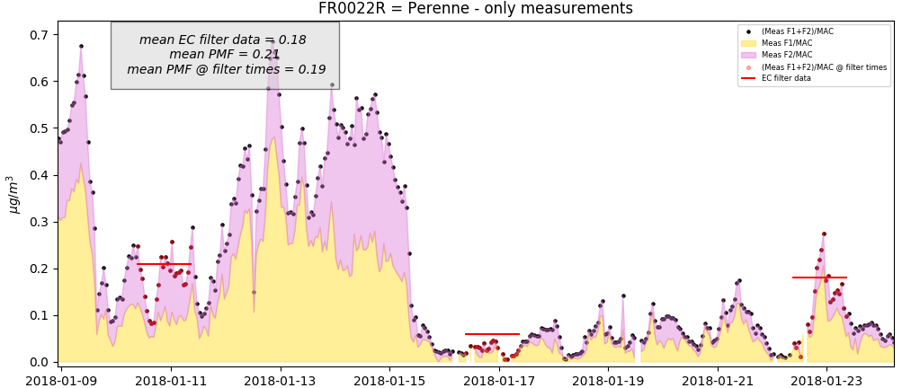
EMEP/ACTRIS/COLOSSAL field campaign
Measurement
campaign
Factor 1: lowest wavelength dependence of light absorption (low angstrom exponent); likely ‘clean’ combustion producing relatively few organic, aromatic/ conjugated systems with light absorbing properties. -> Fossil fuel burning
Factor 2: highest wavelength dependence of absorption (high angstrom exponent); likely ‘dirty’ combustion producing organic, aromatic/ conjugated systems with light absorbing properties. ~everything that is not traffic in most places.
-> Wood burning
Measurements campaign coordinated by Stephen Matthew Platt, NILU
Notes:
Factor 1: lowest wavelength dependence of light absorption (low angstrom exponent); likely ‘clean’ combustion producing relatively few organic, aromatic/ conjugated systems with light absorbing properties. ~traffic in most places.
The Observatoire Pérenne de l'Environnement (OPE) station is a rural ... Map of France
Factor 2: highest wavelength dependence of absorption (high angstrom exponent); likely ‘dirty’ combustion producing organic, aromatic/ conjugated systems with light absorbing properties. ~everything that is not traffic in most places.

Slide 4
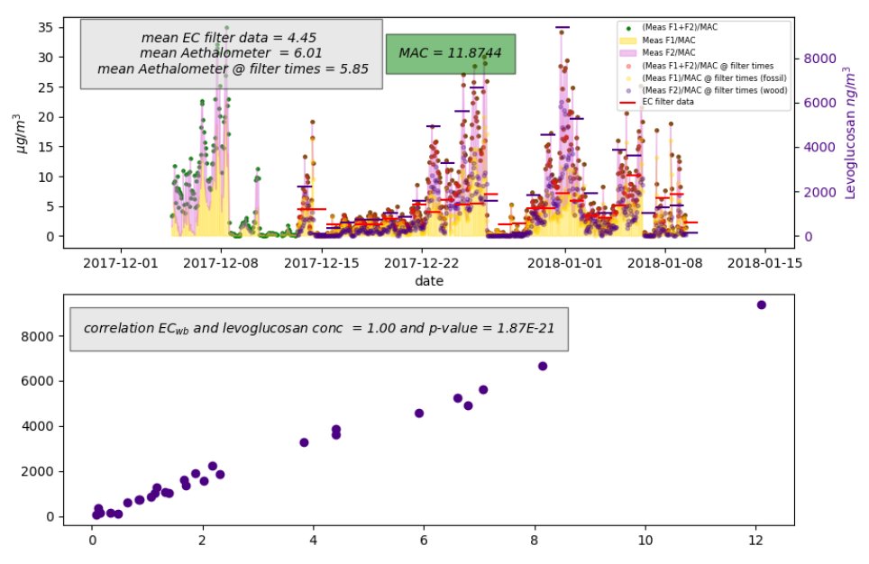
EMEP/ACTRIS/COLOSSAL field campaign
Measurement
campaign
Levoglucosan (C₆H₁₀O₅) is an organic compound formed from the burning of carbohydrates, such as starch and cellulose.
It often used as a chemical tracer for biomass burning.
Measurement from Sarajevo

Slide 5
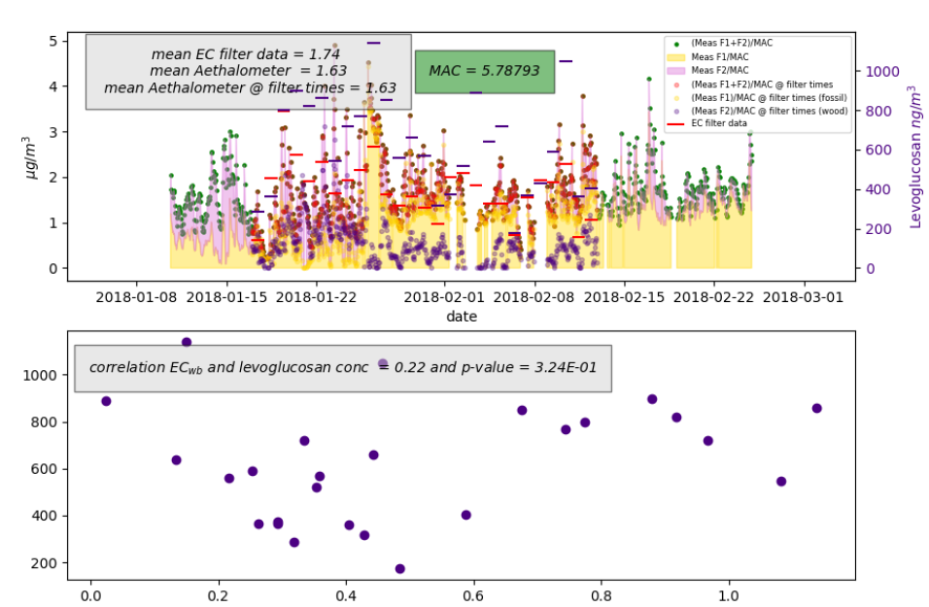
EMEP/ACTRIS/COLOSSAL field campaign
Measurement
campaign
Levoglucosan (C₆H₁₀O₅) is an organic compound formed from the burning of carbohydrates, such as starch and cellulose.
It often used as a chemical tracer for biomass burning.
Measurement from Bologna
Notes:
Why station Bologna is so weird? PMF not reflecting woodburning well?
Something end up in woodburning that is not woodburning. Other dirty combustion? Ships? What ends up in the woodburning fraction. Other dirty combustion sources?

Slide 6



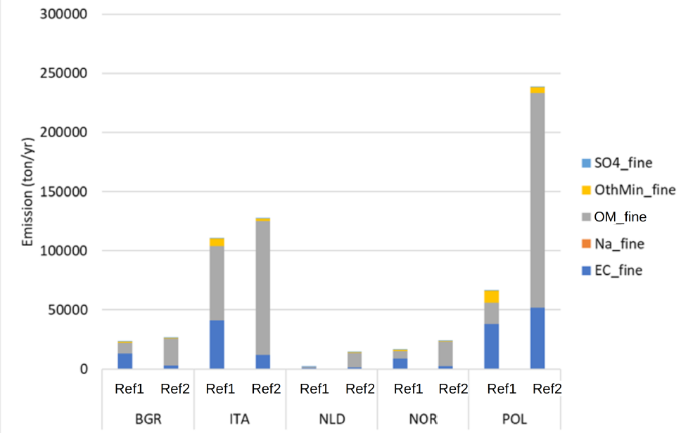
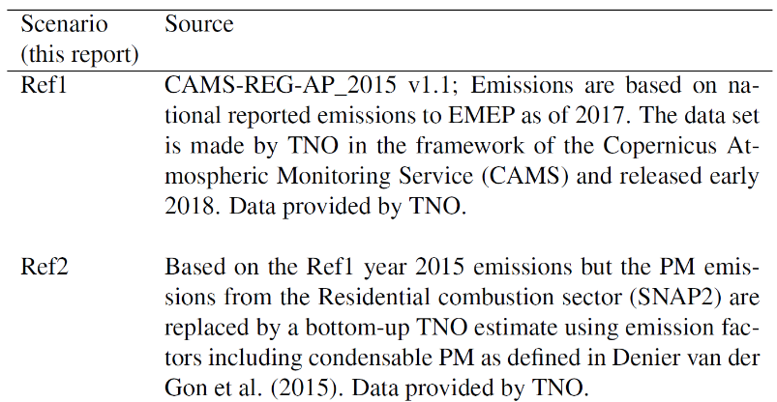
MODEL EMISSION INPUT
Model run
Testing inventories with different condensable components
As part of other research projects TNO has produced a ‘Ref2’ inventory, with a best-estimate for each country of the POM (*) when condensable SVOC (**) are included.
(*) Particulate organic matter (POM) is the organic matter that retains evidence of its original cellular structure. It includes partially decomposed detritus and plant material, pollen.
(**) semi-volatile organic compounds (SVOC): , e.g. Chlorophenyl Phenyl is released mainly from the burning of coal and oil, as well as from the evaporation of gasoline. Type of VOCs, which are ~85% from natural origin (Isoprene from trees), but also anthropogenic from paints and coatings and forest fires.
Denier van der Gon (2015) doi:10.5194/acp-15-6503-2015
Notes:
Highlight EC goes down in Italy
Table 5.2 summarises the two emission inventories used in this work, and here we briefly
outline their background. The CAMS-REG-AP_2015 v1.1 for 2015, which we refer hereafter
to as ‘Ref1’, is based upon data reported to EMEP, and thus represents the emission inventory
normally used in EMEP modelling. As part of other research projects including CAMS-71,
TNO has produced a ‘Ref2’ inventory, with a best-estimate for each country of the POM when
condensable SVOC are included. It should be noted that here we make use only of the SNAP-
2 changes in POM/SVOC (from residential wood combustion and coal), not changes in other
compounds or sectors.
Currently residential wood combustion (RWC) is increasing in Europe because of rising fossil fuel prices but also due to climate change mitigation policies. However, especially in small-scale applications, RWC may cause high emissions of particulate matter (PM). Recently we have developed a new high-resolution (7×7km) anthropogenic carbonaceous aerosol emission inventory for Europe. The inventory indicated that about half of the total PM2.5 emission in Europe is carbonaceous aerosol and identiﬁed RWC as the largest organic aerosol source in Europe. The inventory was partly based on national reported PM emissions.

Slide 7
LOTOS-EUROS settings
Model run
Two emission inventories + EC_ff and EC_wb
Version: v2.2.001 (mainly default settings)
Grid: grid.name : CAMS-II
    resolution (0.1ºx0.1º ~10x10km)
Period: [2017-12-01, 2018-03-01]
Modifications:
    Specs for output : ec_c ec_ff ec_wb
14 labels :
'RoadTransport exhaust gasoline',
'RoadTransport exhaust diesel',
'RoadTransport exhaust LPG',
'RoadTransport non-exhaust',
'Other Stationary Combustion’, ~Residential comb
'Public Power',
'Industry',
'Shipping',
'Aviation',
'Other sectors',
'Natural',
'Boundary',
'Init',
'Aloft'
ec_f splitted with wbfactor
(Thanks to John Douros, KNMI)
(Thanks to Richard Kranenburg, TNO)

Slide 8

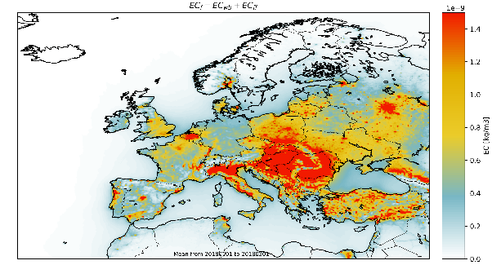
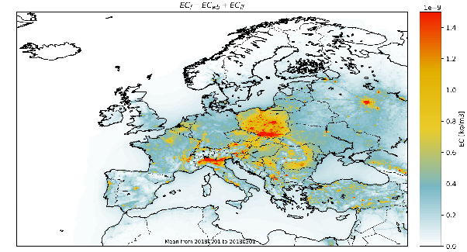
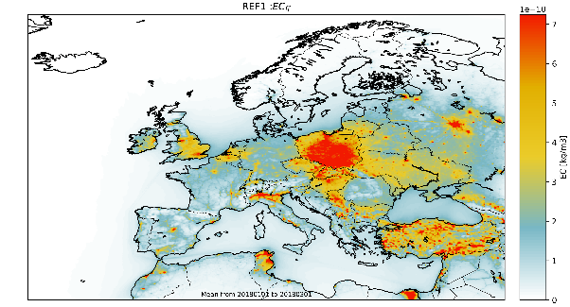
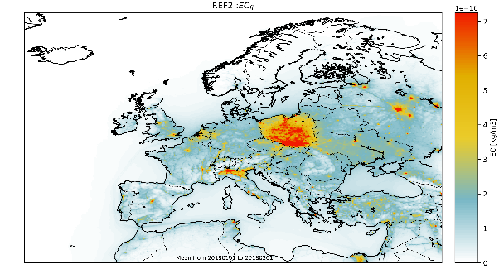
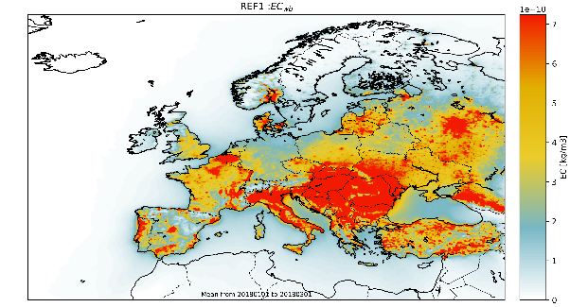
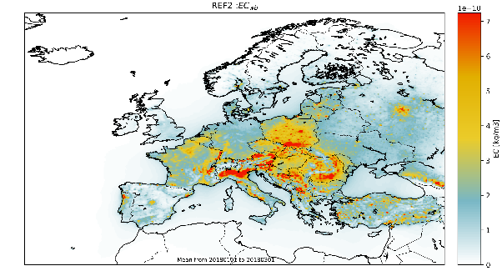
Comparing the two emission sets
Model results
  total
  total
  REF 1
  REF 2
  EC_ff
  EC_ff
  EC_wb
  EC_wb
Notes:
Refer to Augustin. He probably showed this

Slide 9
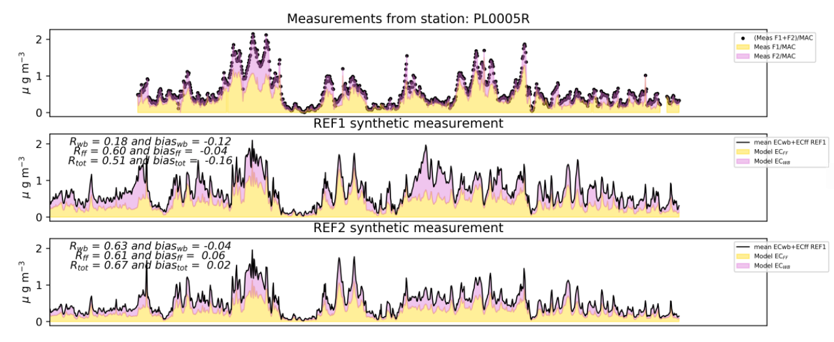
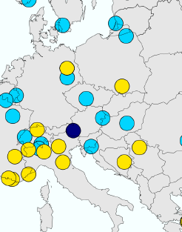
Agreement with EMEP/ACTRIS/COLOSSAL field campaign stations
Model results
Interpolating to station longitude and latitude
Diabla Góra

Slide 10
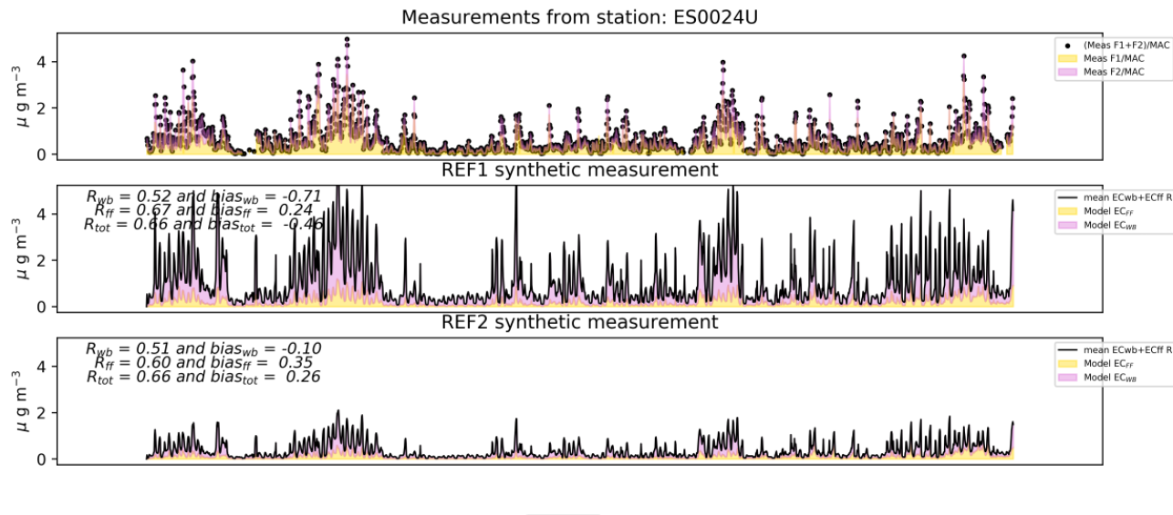
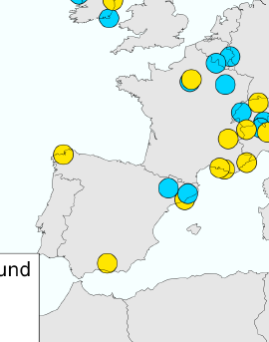
Agreement with EMEP/ACTRIS/COLOSSAL field campaign stations
Model results
Interpolating to station longitude and latitude
Diabla Góra
Coruna

Slide 11
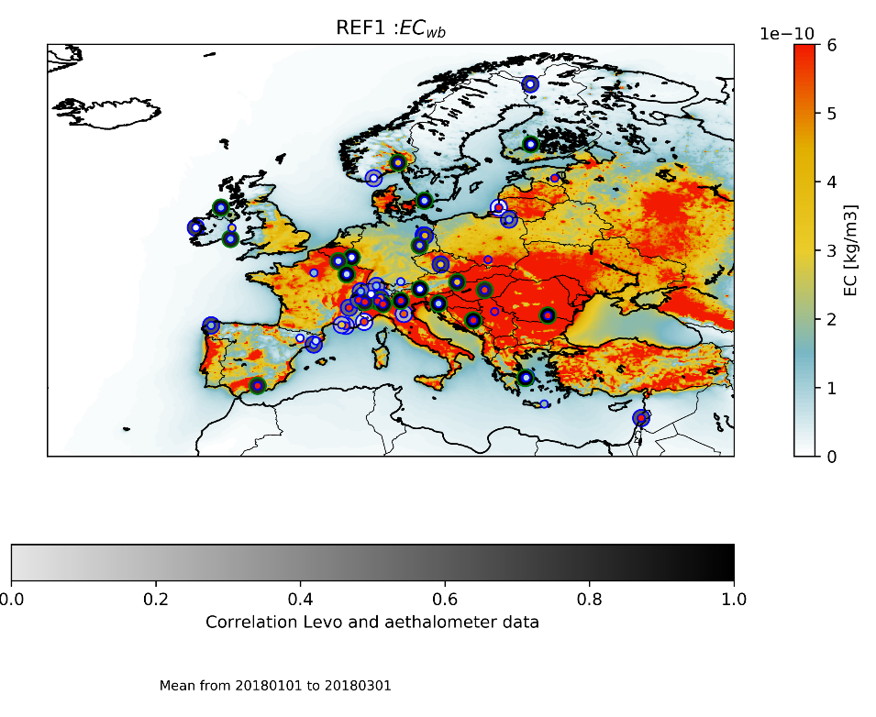
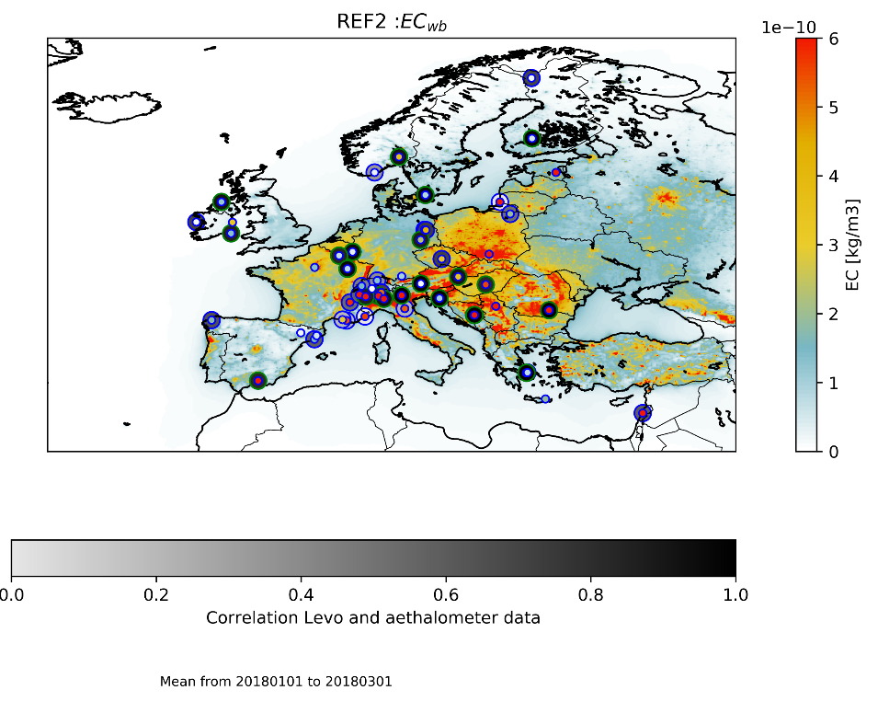
CHERRY PICKING
Model results
Stations with R>0.8 between estimated Wbfraction and Levoglucosan we call reliable.
Notes:
EC wb ref 1

Slide 12
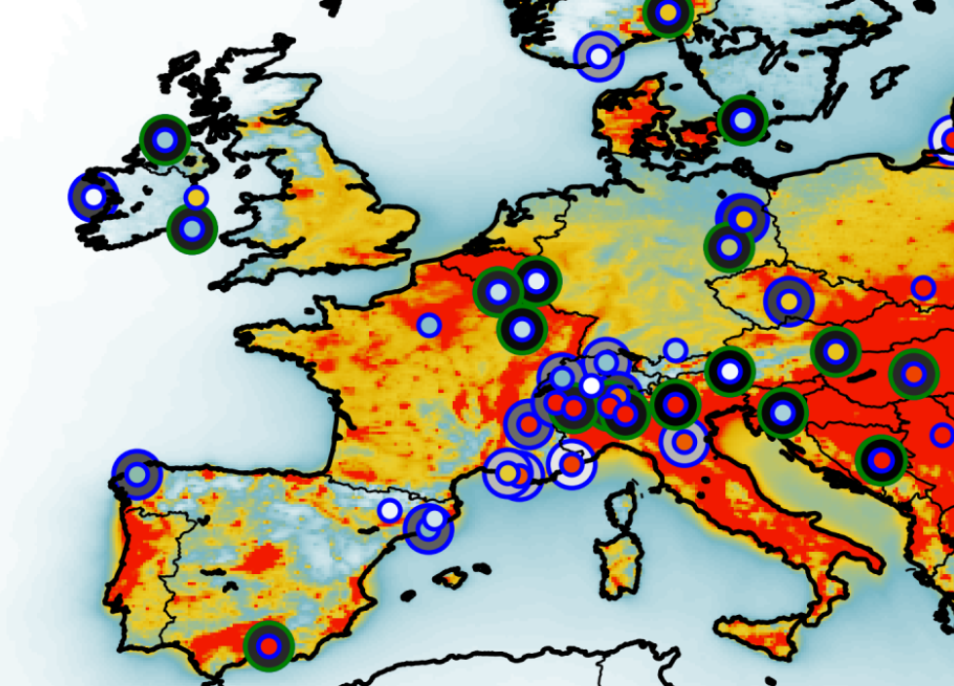
CHERRY PICKING
Model results
Stations with R>0.8 between estimated Wbfraction and Levoglucosan we call reliable.
Notes:
EC wb ref 1

Slide 13
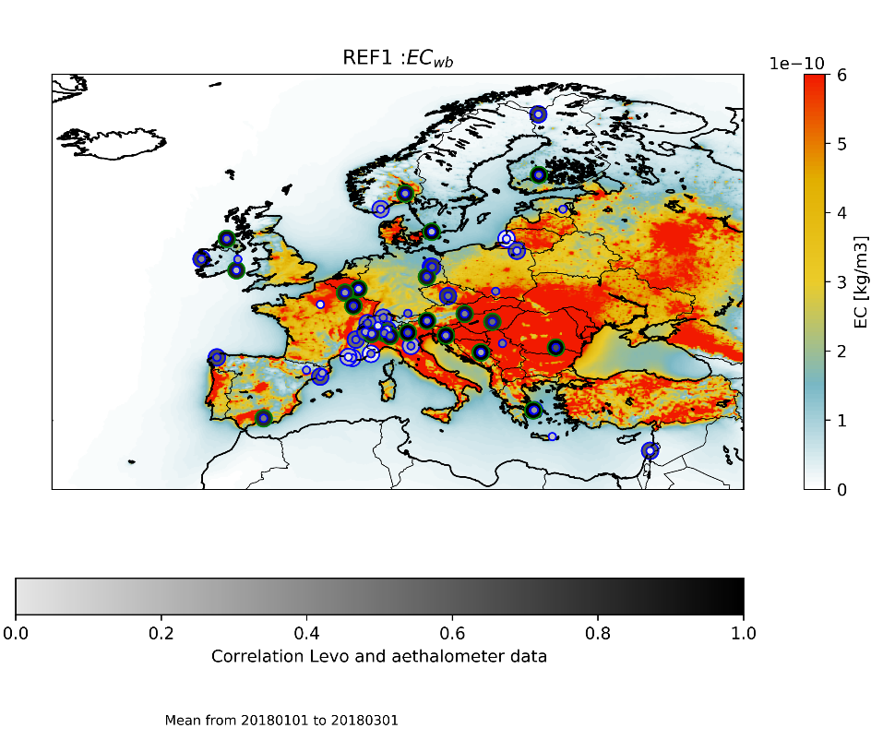
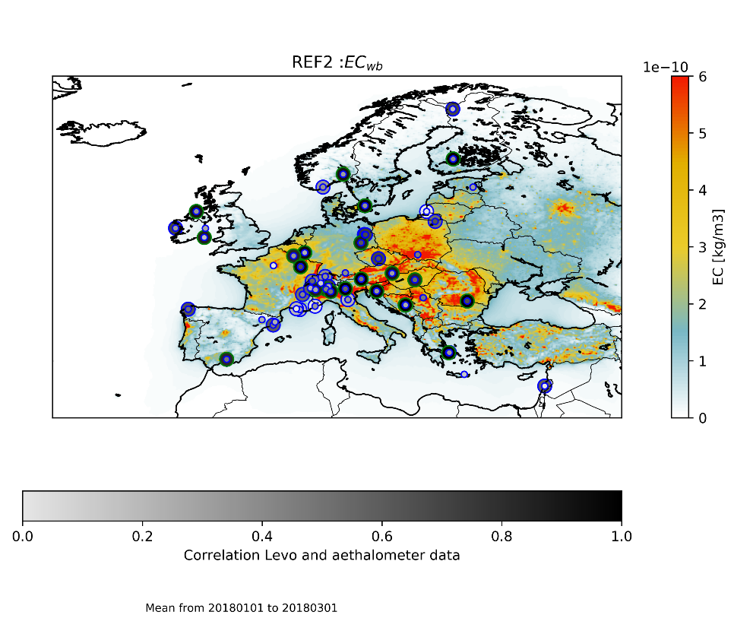
CHERRY PICKING
Model results
Correlations
Rwb = 0.33
Rwb = 0.37
Rwb = 0.36
Rwb = 0.39
Rtot = 0.42
Rtot = 0.47
Rtot = 0.44
Rtot = 0.49

Slide 14
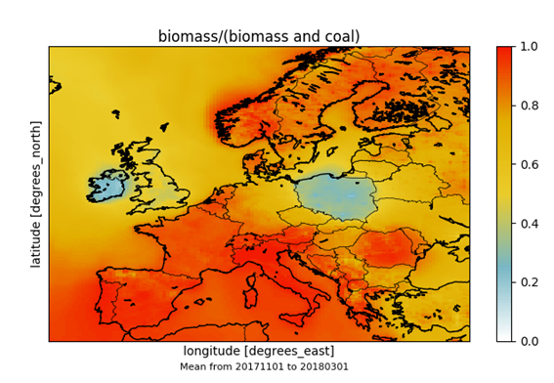
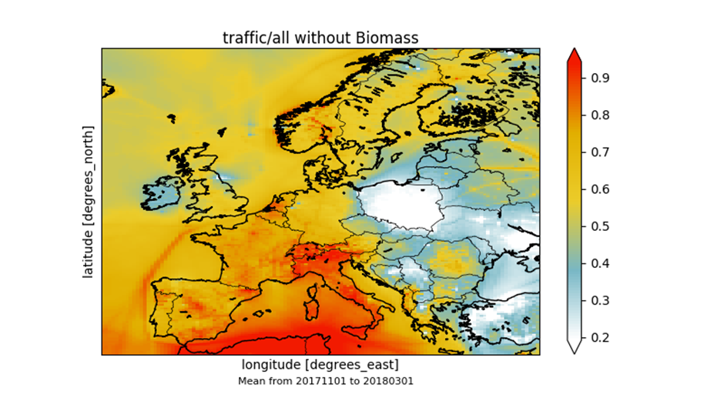
PREVIOUSLY: EC from different sources compared
Are we comparing the right things?
‘wb’ tag model
‘wb’ tag obs
‘ff’ tag obs
‘ff’ tag models

Slide 15
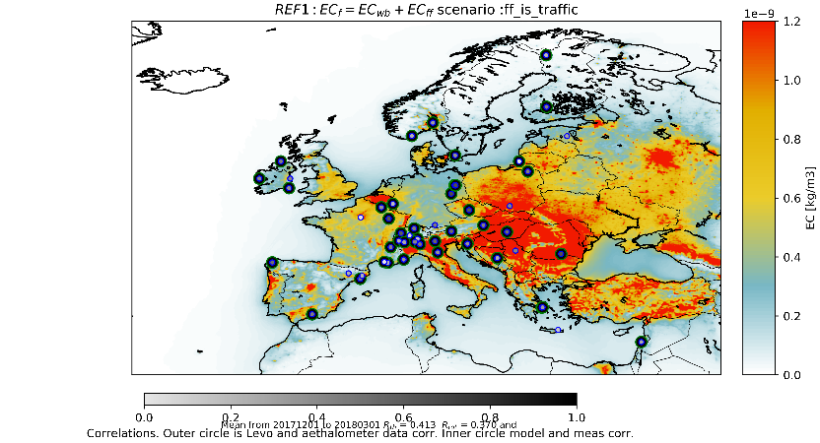
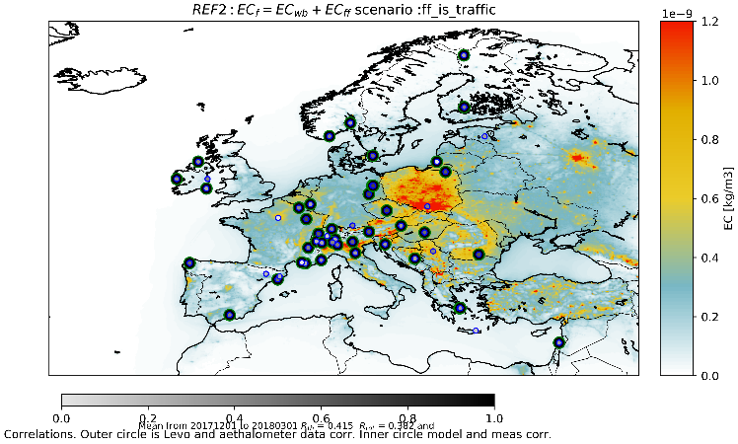
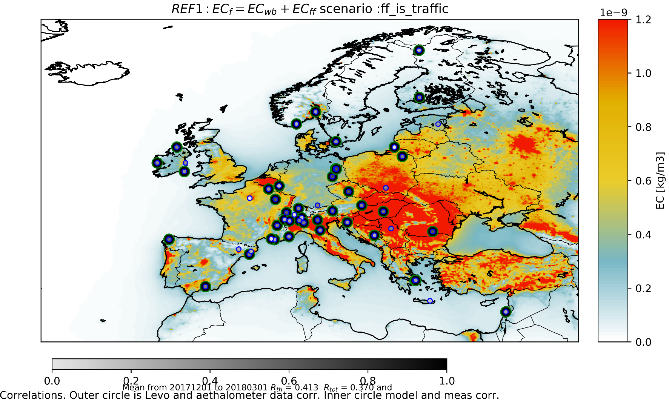
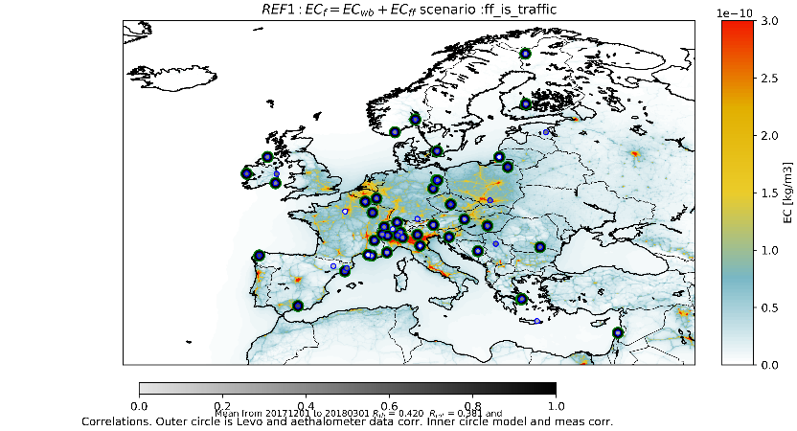
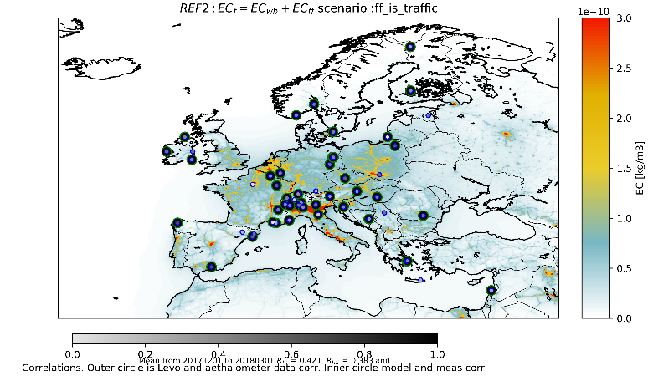
SCENARIO 1 ff~traffic
Model results
EC_{wb}
EC_{wb}
Looking at labelled results
EC_{ff}
EC_{ff}
 | Original | Scenario 1: ff~traffic
REF1 R_ff, R_wb REF2 R_ff, R_wb | 0.37, 0.39 0.47, 0.49 | 0.420, 0.413 0.421, 0.415
REF 2 better than REF 1
Scenario 1 better R for ff contribution
Scenario 1 worse R for bb contribution
Notes:
The Inner circle is the correlation this time.

Slide 16

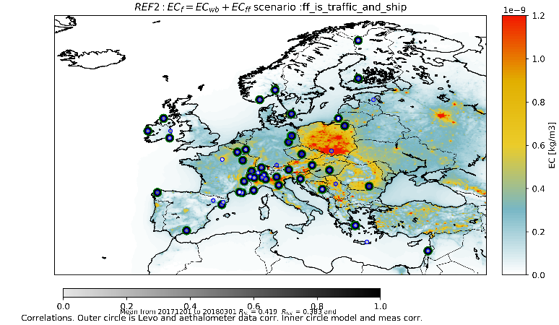
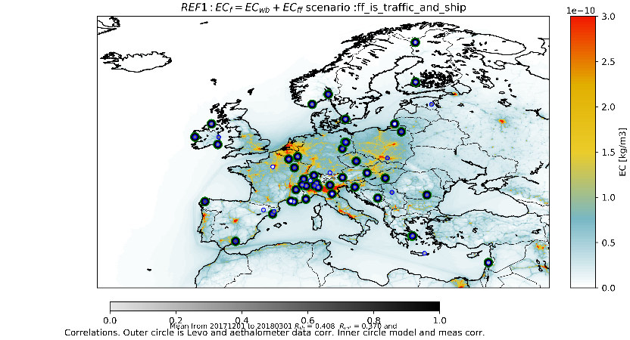
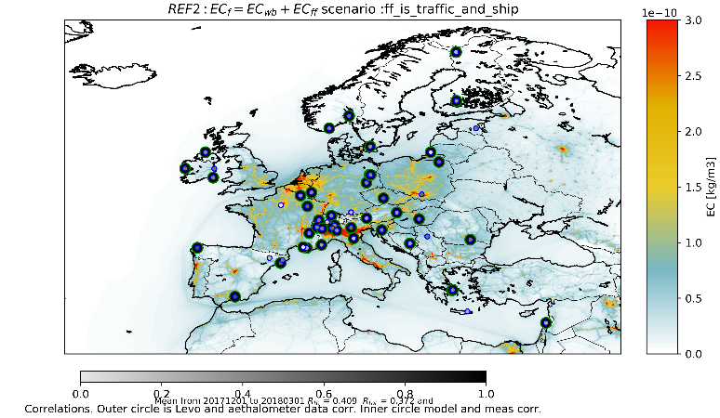
SCENARIO 2 ff~traffic+shipping
Model results
EC_{wb}
EC_{wb}
Looking at labelled results
EC_{ff}
EC_{ff}
REF 2 better than REF 1
Scenario 2 worse R ff contribution than scenario 1
Scenario 2 better R bb contr. than scen. 1 but both are worse than original
 | Original | Scenario 1: ff~traffic | Scenario 2: ff~traffic +shipping
REF1 R_ff, R_wb REF2 R_ff, R_wb | 0.37, 0.39 0.47, 0.49 | 0.420, 0.413 0.421, 0.415 | 0.408, 0.415 0.409, 0.419

Slide 17
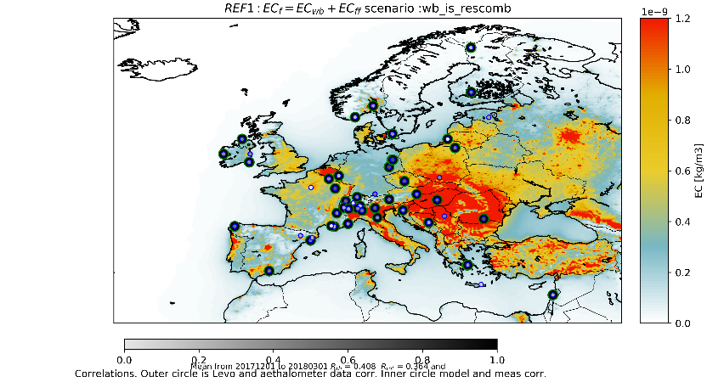
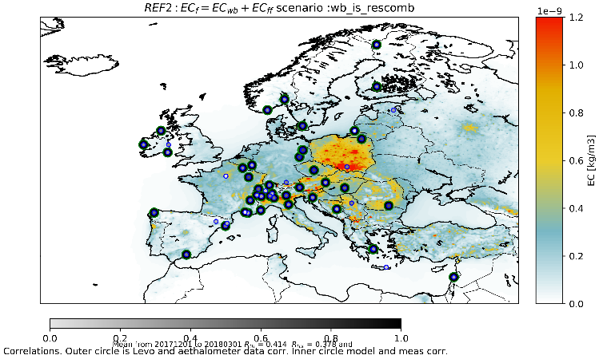
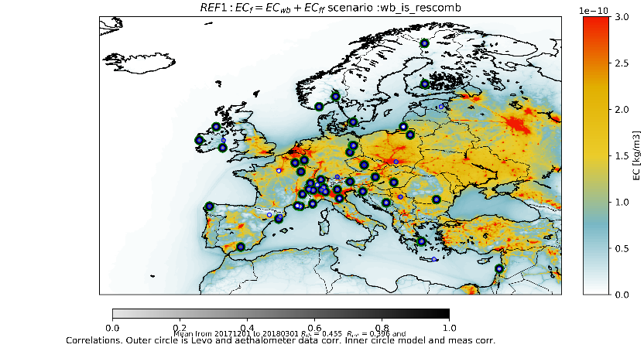
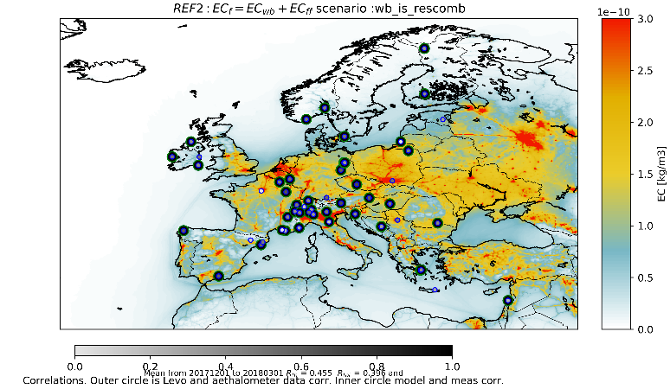
SCENARIO 3 wb~ res. combustion
Model results
EC_{wb}
EC_{wb}
Looking at labelled results
EC_{ff}
EC_{ff}
 | Original | Scenario 1: ff~traffic | Scenario 2: ff~traffic +shipping | Scenario 3: wb~res_com
REF1 R_ff, R_wb REF2 R_ff, R_wb | 0.37, 0.39 0.47, 0.49 | 0.420, 0.413 0.421, 0.415 | 0.408, 0.415 0.409, 0.419 | 0.455, 0.408 0.455, 0.414
REF 2 correlates better with meas than REF 1
Scenario 3 REF 1 best R ff contribution

Slide 18
All statistics
RMSE
(1e-9) kg/m3 | Original | Scenario 1: ff~traffic | Scenario 2: ff~traffic+ship | Scenario 3: wb~res_com
REF1 RMSE_ff/RMSE_wb - all REF2 RMSE_ff/RMSE_wb - all | 16.62/29.11 19.72/11.67 | 24.38/31.91 24.40/11.48 | 24.02/31.54 24.05/11.31 | 21.43/28.90 21.53/10.52
REF1 RMSE_ff/RMSE_wb - sel REF2 RMSE_ff/RMSE_wb - sel | 18.89/ 40.09 20.54/10.25 | 23.93/45.58 23.93/11.38 | 23.55/45.21 23.54/11.08 | 20.94/42.32 20.96/10.22
bias
No labelling strategy is clearly better than the initial labelling
REF2 is an improvement in bias and RMSE compared to REF1
(1e-9) kg/m3 | Original | Scenario 1: ff~traffic | Scenario 2: ff~traffic+ship | Scenario 3: wb~res_com
REF1 bias_ff/bias_wb - all REF2 bias_ff/bias_wb - all | 0.39/-0.56 0.50/0.12 | 0.65/1.25 0.65/-0.03 | 0.64/-0.80 0.64/-0.02 | 0.55/-0.72 0.56/0.06
REF1 bias_ff/bias_wb - sel REF2 bias_ff/bias_wb - sel | 0.50/ -1.09 0.56/0.13 | 0.66/-0.81 0.66/0.03 | 0.65/-1.24 0.65/0.04 | 0.58/-1.16 0.58/0.12
correlations
 | Original | Scenario 1: ff~traffic | Scenario 2: ff~traffic+ship | Scenario 3: wb~res_com
REF1 R_ff/R_wb - all REF2 R_ff/R_wb - all | 0.33/0.36 0.42/0.44 | 0.381/0.364 0.383/0.382 | 0.370/0.370 0.383/0.372 | 0.396/0.364 0.396/0.378
REF1 R_ff/R_wb - sel REF2 R_ff/R_wb - sel | 0.37/0.39 0.47/0.49 | 0.420/0.408 0.421/0.415 | 0.408/0.415 0.409/0.419 | 0.455/0.408 0.455/0.414
Notes:
Bias and rmse much smaller for REF 2 wb fraction

Slide 19
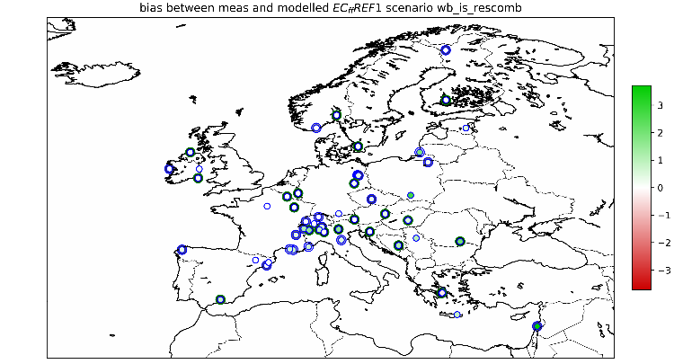

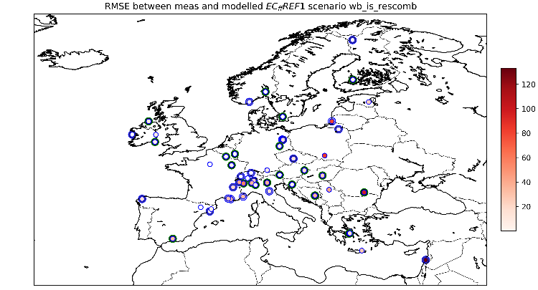
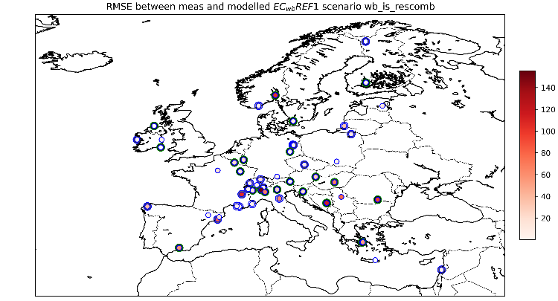
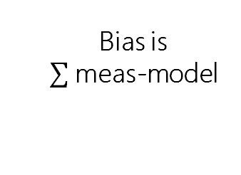
Distribution of Errors
Bias is
meas-model
Scenario 3: wb~res_com REF 1
REF 1
Central Europe: ff is overestimated by the model
wb burning is underestimated
Bias EC_{ff}
Bias EC_{wb}
RSME EC_{ff}
RSME EC_{wb}

Slide 20

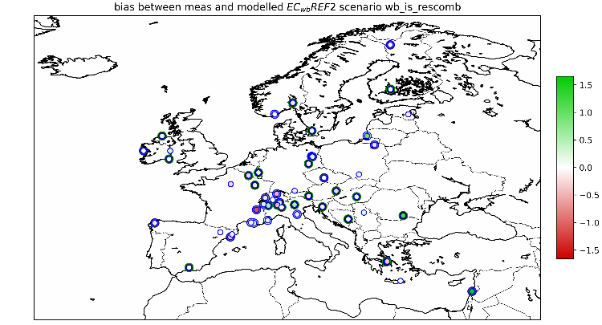

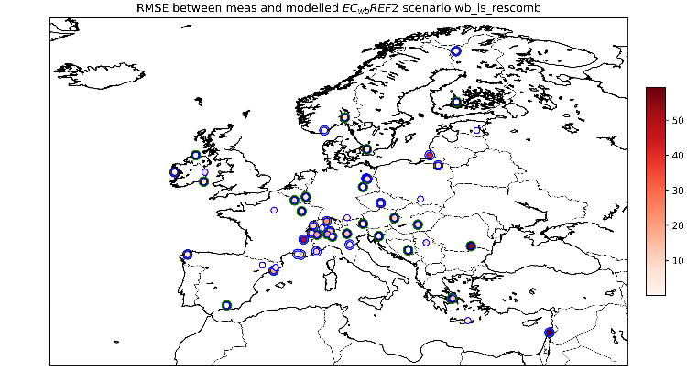
Distribution of Errors
Bias is
meas-model
Scenario 3: wb~res_com REF 2
REF 2
Central Europe: ff is still overestimated by the model
wb burning seems better. Note the colorbar range
Bias EC_{ff}
Bias EC_{wb}
RSME EC_{ff}
RSME EC_{wb}

Slide 21
CONCLUSIONS
No evident big improvement in correlations is found for the various selected scenarios w.r.t. the ‘old’ labelling strategy, i.e. wb/ff faction defined in emission. Also no clear deterioration is found. An improvement is seen in the WB description of REF 2 w.r.t. REF 1 (in correlations).
Ref 2 mainly improves the bias and RSME between the modelled and measured wb component of EC.
Improve selection of stations.-> also model based
Model has recieved a minor update, as well as the emission time profiles. Check if results change.
Write down the study presented here within a more elaborate REF1 and REF2 comparison
OUTLOOK

Slide 22
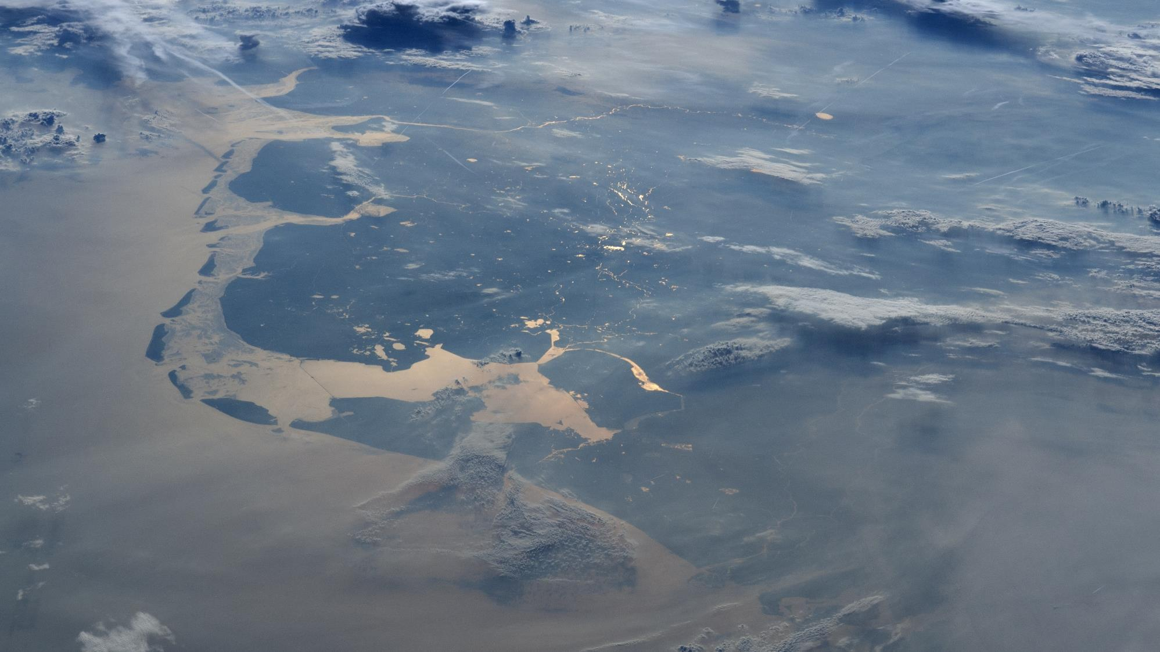
Thank you for Your time
Any QUESTIONS ?

